Slide 1
Customer Retention Project Report
.

Slide 2
Slide Title
Introduction
Data set
Progress
Result

Slide 3
Introduction
We all know about the e-commerce which is the online platform from where we sell or buy our goods and services, or the transmitting of funds or data over the internet. In this project, we have to analyze the data of success factor of e-commerce websites. To present the models for customer activation and retention, a thorough assessment of the literature, theories, and models was conducted. Service quality, system quality, information quality, trust, and net benefit were recognised as five important factors that contributed to the success of an e-commerce store. The study also looked into the elements that influence the likelihood of repeat purchases by internet clients. To positively influence repeat purchase intention (loyalty), a combination of utilitarian and hedonistic values is required. The information was gathered from Indian online shoppers. The findings reveal the key e-commerce success elements that influence client happiness.

Slide 4
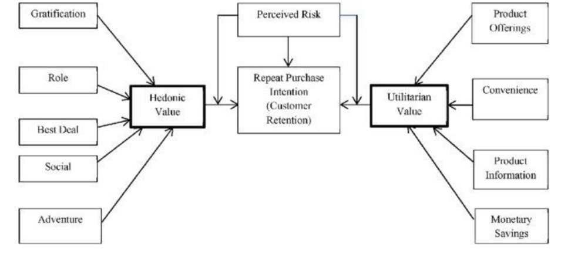
Data set
We were given a dataset by Flip Robo, from where I am doing my internship. This data is customer retention data The data is collected from the Indian online shoppers. Results indicate the e-retail success factors, which are very much critical for customer satisfaction.

Slide 5
Processing
We first opened the Jupyter notebook so that we start making the model, after this we ha ve imported the library and loaded the dataset . We have calculated the shape of the data “The dataset have 71 columns or attributes and 269 rows representing each respondant's answers values of each attribute. After that checking that we need to check the column a nd Instanciating the list of columns name and Renaming the old columns of the dataset wi th the modified columns name. Checking the dataset after renaming the columns name. H ere is the plot and mapping of the data

Slide 6
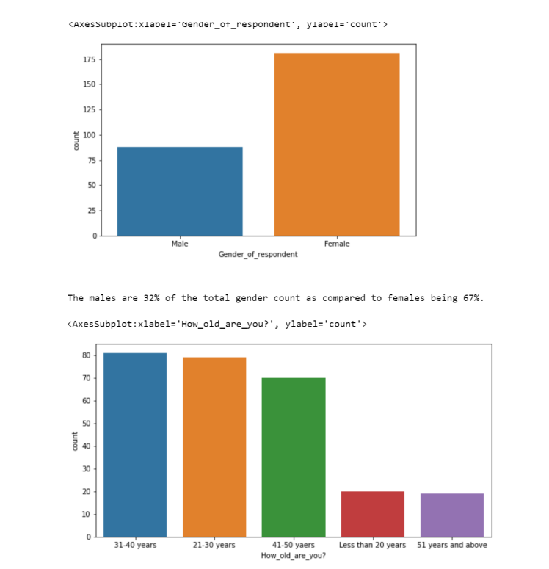
.

Slide 7
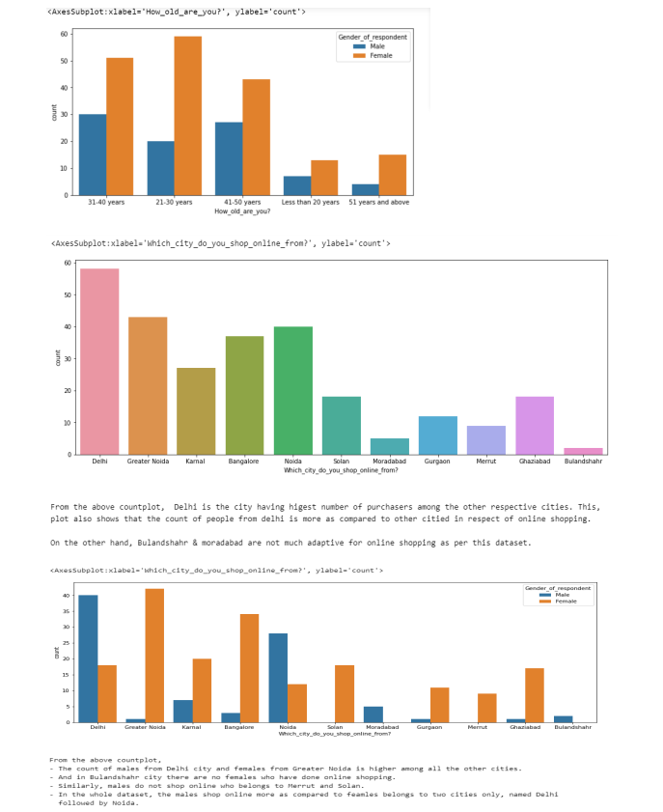
.

Slide 8
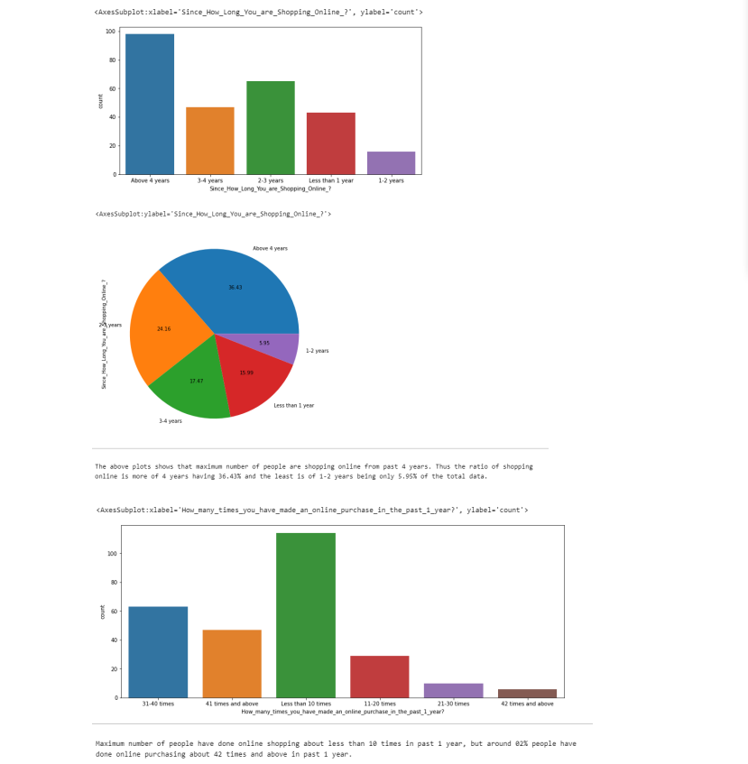
.

Slide 9
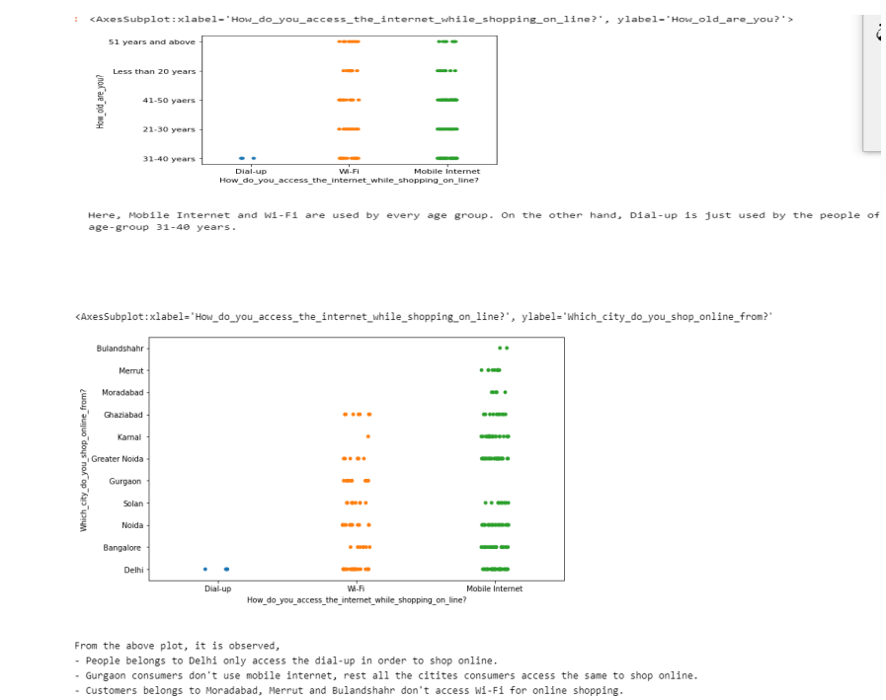
.

Slide 10
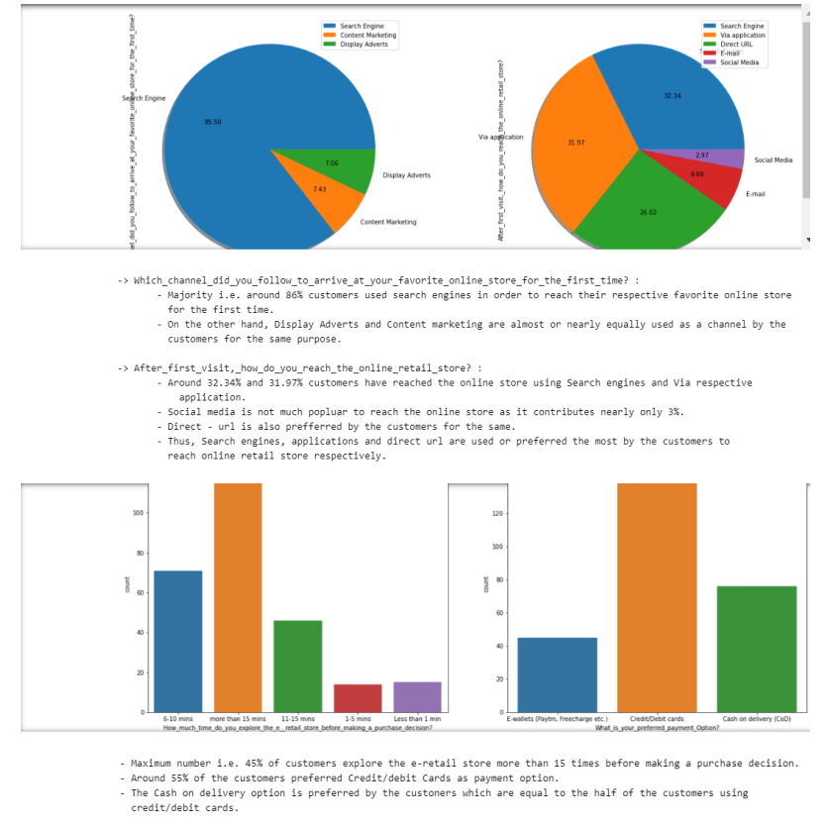
.

Slide 11
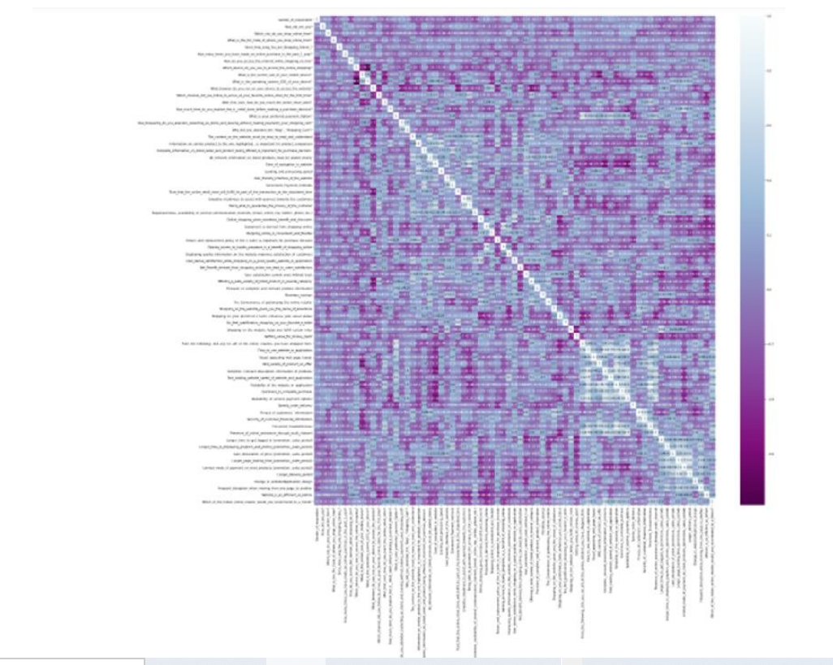
Result

Slide 12
.
THANK YOU

